Slide 1



Slide 2
Introduction
Sarbani Dutta
Assistant teacher
Lamatashi Gps
Bahubal,Hobigonj.

Slide 3
Class- Two
Sub- English
Unit 6,Lets draw
Lesson 2
A)Look at Mr shape.
B)Count and say.

Slide 4
Learning outcomes
Students will be able to
1)listen the lesson attentively.
2)say about four kinds of shapes.
3)count and say circles,squares
rectangles and triangles.
4)draw four kinds of shapes.

Slide 5
Now we see a song

Slide 6

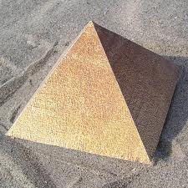
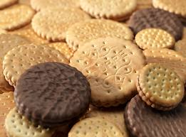
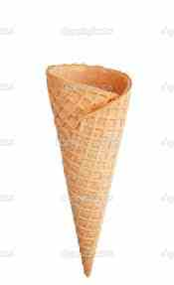
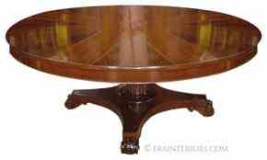
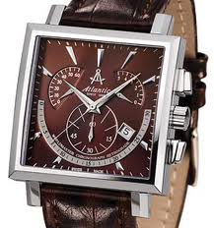
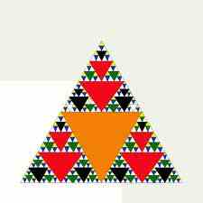
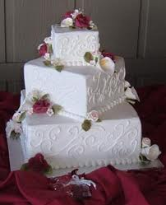
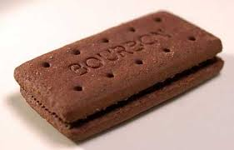
Many kinds of
shapes

Slide 7



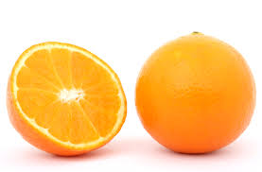
Many
Kinds
Of
circles

Slide 8
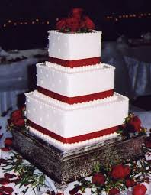
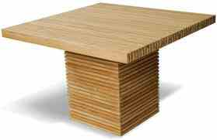
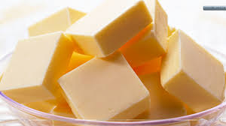
Many
Kinds
Of
squares

Slide 9
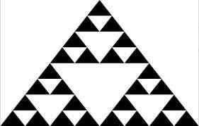
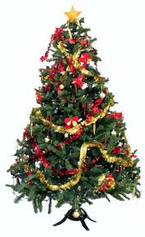
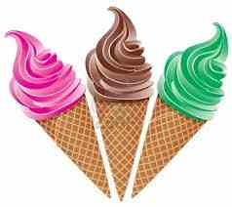
Many
Kinds
of
triangles

Slide 10

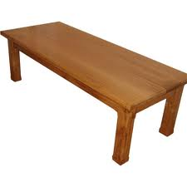


Many
Kinds of
rectangles

Slide 11
Names of the shapes
circle
triangle
square
rectangle

Slide 12
Now we see, how to ready Mr shape with four shapes.

Slide 13
Coming
Mr
Shape

Slide 14
Now today we
look
Mr shape

Slide 15
I
Triangles
Circles
am
Mr
Squares
Rectangles
Shape

Slide 16
Count and say
1)How many circles?
2)How many squares?
3)How many rectangles?
4)How many triangles?

Slide 17
Group work
Team-Red
Team-yellow
Draw this
Draw this

Slide 18
Open your book
Page no36.
Draw this

Slide 19


bye
Good
Mr
Shape

